Slide 1

Why do people leave?
Human Resource analysis for explaining and predicting attrition rates
Notes:
30 sec

Slide 2
16% of our employees resigned
The purpose of our work is to understand who are these employees and help Human Resources team to increase retention, by being able to predict attrition rates.
To achieve that goal, we will explore three main points:
Identify the importance that the distance from home has over the attrition rates;
Perform a cluster analysis of company’s employees, to identify the characteristics that better explain employee’s attrition;
Create and apply a predictive Machine Learning Algorithm that helps predict attrition behaviours.
Notes:
30 seg

Slide 3
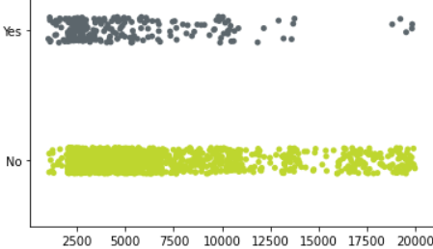
Salary is a key factor in retention…
Attrition distribution per monthly income and total working years
Key takeaways
Most resignations happen for employees with lower salaries;
The average monthly income for employees who are leaving the company is approximately $5.000, against almost $7.000, for the employees who are not leaving.
Attrition
Monthly Income
Notes:
1 min

Slide 4
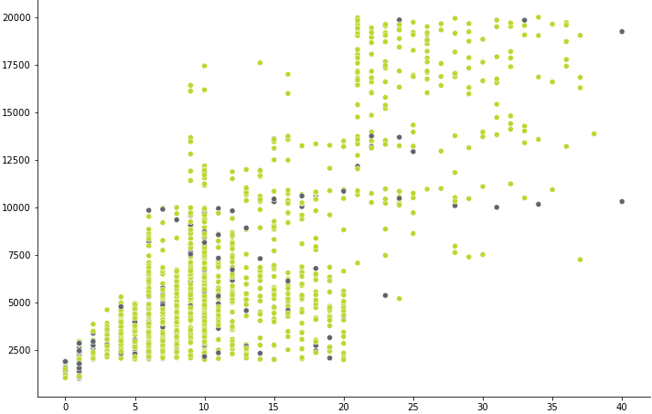
But salary solely does not explain it all
Attrition distribution per monthly income and total working years
Key takeaways
Employees with lower salaries tend to resign the most, however this seems to be accompanied by a low seniority;
Most resignations happen in the first 20 years of employees’ career;
Monthly income
Legend
Employed
Resigned
Total working years
Notes:
1 min

Slide 5
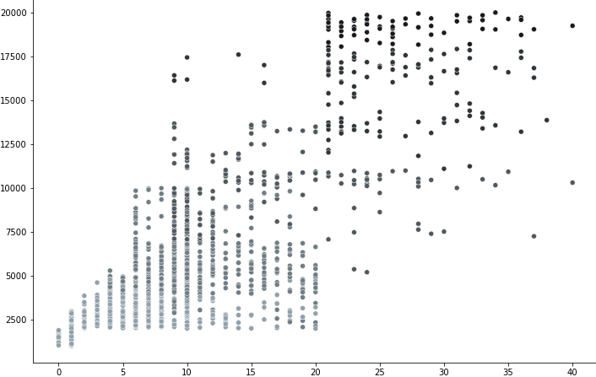
But salary solely does not explain it all
Job level per monthly income and total working years
Key takeaways
Employees with lower salaries tend to resign the most, however this seems to be accompanied by a low seniority;
Most resignations happen in the first 20 years of employees’ career;
It takes time and experience to get to higher salary brackets;
Monthly income
Job level
1
2
3
4
5
Total working years
Notes:
1 min 30

Slide 6
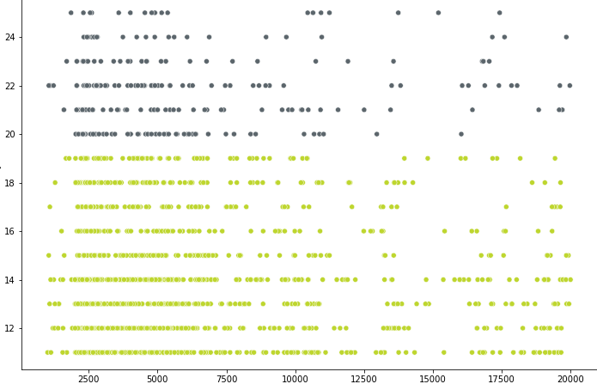
But salary solely does not explain it all
% salary hike per performance rating and monthly income
Key takeaways
Employees with lower salaries tend to resign the most, however this seems to be accompanied by a low seniority;
Most resignations happen in the first 20 years of employees’ career;
It takes time and experience to get to higher salary brackets;
Higher performance levels lead to higher salary hikes.
Performance rating
3
4
% salary hike
Monthly income
Notes:
1 min 30

Slide 7
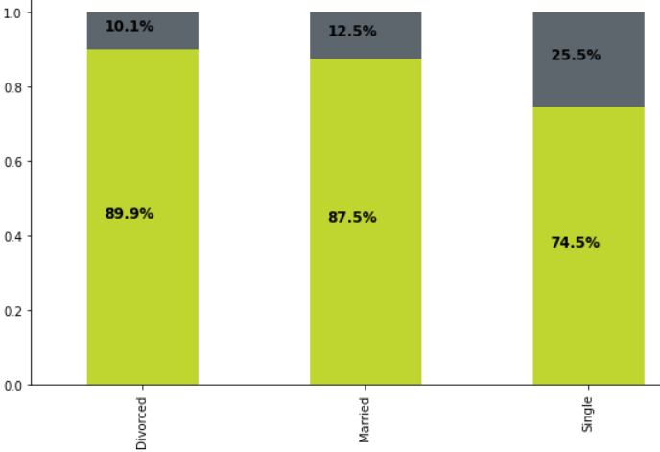
Single employees, Sales representatives, employees that travel frequently in business and employees who work over time, all have one thing in common…high attrition
Proportion of attrition per marital status
10,1%
12,5%
Key takeaways
Almost 25% of employees that are single have resigned, which is more than the combined proportion of divorced and married employees, who have resigned;
25,5%
Attrition proportion
Legend:
No attrition
Attrition
Marital Status
Notes:
1 min 30

Slide 8
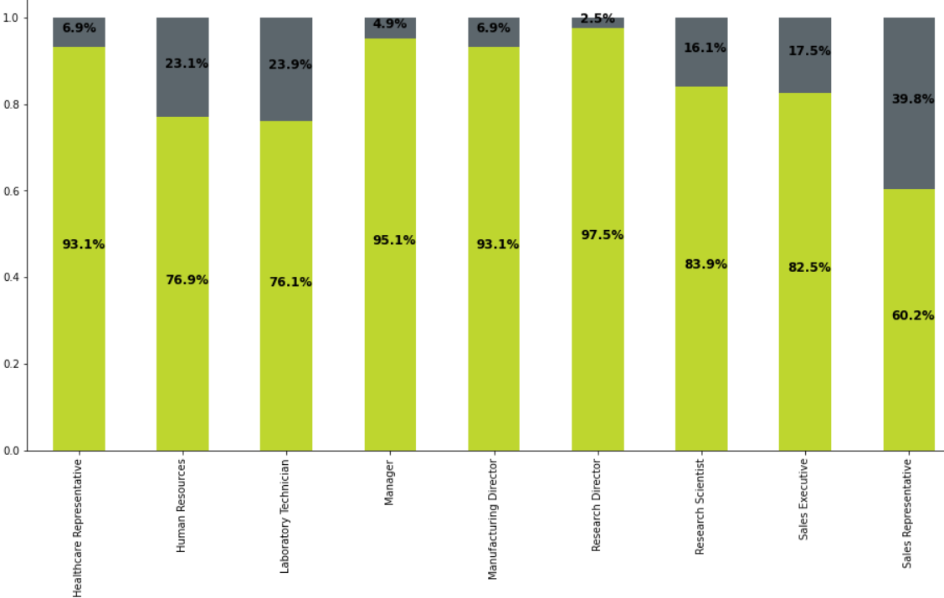
Single employees, Sales representatives, employees that travel frequently in business and employees who work over time, all have one thing in common…high attrition
Proportion of attrition per job role
2,5%
Key takeaways
Almost 25% of employees that are single have resigned, which is more than the combined proportion of divorced and married employees, who have resigned;
Almost 40% of employees working as Sales representative have resigned;
6,9%
4,9%
6,9%
23,1%
23,9%
16,1%
17,5%
39,8%
Attrition proportion
Job Role
Notes:
1 min 30

Slide 9
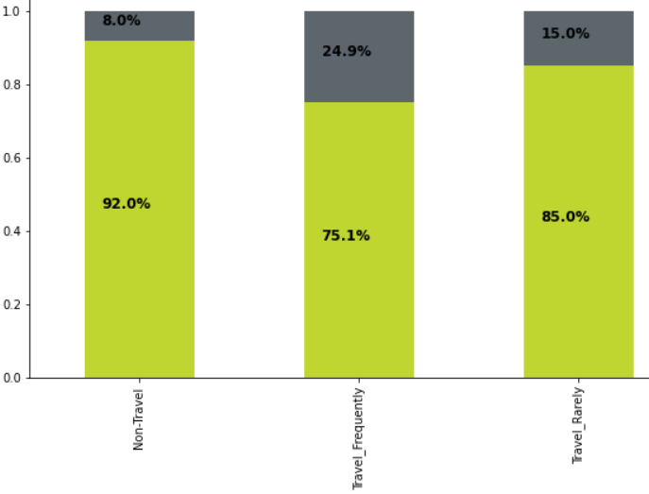
Single employees, Sales representatives, employees that travel frequently in business and employees who work over time, all have one thing in common…high attrition
Proportion of attrition per business travel frequency
Key takeaways
Almost 25% of employees that are single have resigned, which is more than the combined proportion of divorced and married employees, who have resigned;
Almost 40% of employees working as Sales representative resigned;
Almost 25% of employees who travel frequently in business have resigned;
8%
15%
24,9%
Attrition proportion
Travel frequency
Notes:
1 min 30

Slide 10
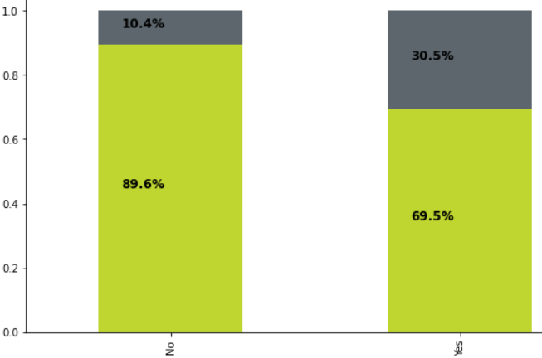
Single employees, Sales representatives, employees that travel frequently in business and employees who work over time, all have one thing in common…high attrition
Proportion of attrition per Overtime
Key takeaways
Almost 25% of employees that are single have resigned, which is more than the combined proportion of divorced and married employees, who have resigned;
Almost 40% of employees working as Sales representative resigned;
Almost 25% of employees who travel frequently in business have resigned;
Almost 31% of employees who work overtime have resigned.
10,4%
30,5%
Attrition proportion
Overtime
Notes:
1 min 30

Slide 11
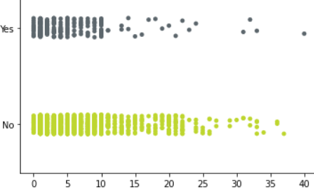
The focus of retention policies should be on recent hiring
Attrition per number of years working at the company
Key takeaways
Most employees resign in the first 10 years working in the company;
The average working time for resigned employees is 5 years, against 7 for the employees who are not resigning.
Attrition
Years at company
Notes:
1 min 30

Slide 12
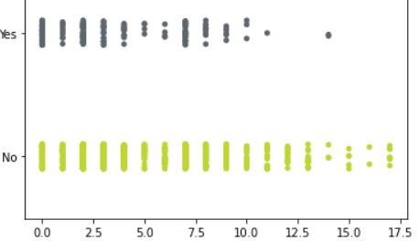
The focus of retention policies should be on recent hiring
Key takeaways
Most employees resign in the first 10 years working in the company;
The average working time for resigned employees is 5 years, against 7 for the employees who are not resigning;
Employees who have left the company, on average, worked under the current manager for less than 3 years, while other employees are working under the same manager for an average period of more than 4 years.
Attrition per number of years working with current manager
Attrition
Years with current manager
Notes:
1 min 30

Slide 13
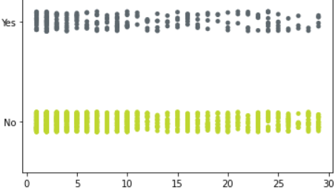
The distance from home is not significantly important to explain attrition
Attrition per distance from home to work
Key takeaways
Distance from home does not seem to make attrition vary significantly;
In average, the distance from home is around 1km higher for employees who left the company.
Attrition
Distance
Notes:
1 min 30

Slide 14
Next steps:
Evaluate the statistical significance that each atribute has over attrition variation, in order to identify the key influencers;
Perform a cluster analysis to create a segmentation of employees’ behaviours when it comes to attrition, which will allow us to identify common characteristics among the different groups and propose retention policies to Human Resources team;
Create and apply a predictive algorithm that helps Human Resources team to identify potential new attrition situations and, hopefully, action soon enough.
Notes:
1 min 30

